Slide 1


Student Athlete College Information
AND
Ryan H. Adams, CMAA (ryan.adams@osceolaschools.net)
Coordinator of Athletics, Physical Education, JROTC and Driver Education
School District of Osceola County, Kissimmee, Florida

Slide 2
Student Athlete College Information
AND
The purpose of this presentation is to provide general information about the NCAA and NAIA regarding the Eligibility process for student athletes who desire to participate at the next level.
Everyone needs a “Blue Print” for success so it is important to know the rules and Procedures that have been set in place.

Slide 3
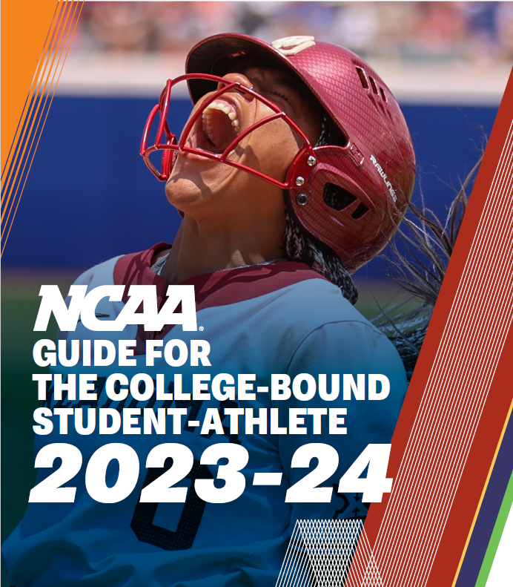
Student Athlete College Information

Slide 4
NCAA &
ELIGIBILITY CENTER
What is the NCAA – National Collegiate Athletic Association that governs over 1,200 Colleges and Universities, Conferences and Organizations while administering 24 sports.
DIVISION I
Offer at least 7 Sports for Men and Women or 6 for men and 8 for women
Offer 2 Teams Sports for each Gender
Offer a certain # of Financial Aid to Student Athletes without going over the maximum allowed
Cleared through the Eligibility Center
DIVISION II
Offer at least 5 Sports for Men and Women or 4 for men and 6 for women
Offer 2 Teams Sports for each Gender
Cleared through the Eligibility Center
DIVISION III
Offer at least 5 Sports for Men and Women
Offer 2 Teams Sports for each Gender
Have student-athletes who do not get sports-related financial aid.
.
What is the NCAA Eligibility Center?

Slide 5
ELIGIBILITY CENTER
In 2007, the NCAA established the “NCAA Eligibility Center, LLC
This replaced the original eligibility “Clearinghouse”
The purpose of the Eligibility Center is to ensure that student athletes pass the same standards that were established by the NCAA in order to participate in College.

Slide 6
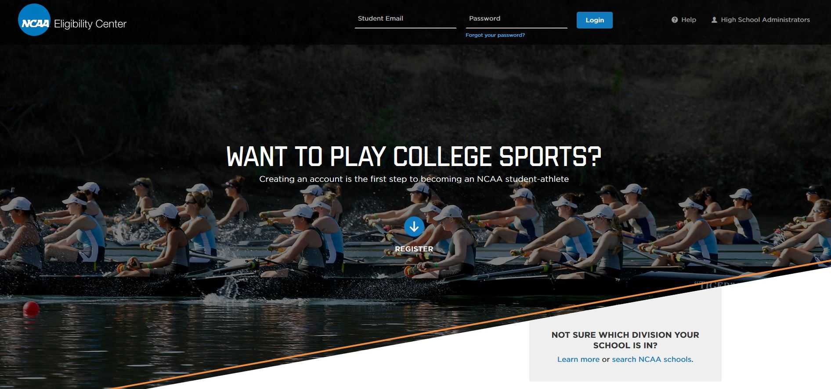
ELIGIBILITY CENTER
www.eligibilitycenter.com
https://web3.ncaa.org/ecwr3/

Slide 7
ELIGIBILITY CENTER
What is the cost for registration?
$100.00 – Which is always subject to change
What is the cost for international students registration?
$160.00 – Which is always subject to change
When do you want to Register for the Eligibility Center?
9th grade year, Register for a FREE Profile Page.
10th Grade - If being actively recruited, then transition your profile to the certification account.
11th Grade – Transition free profile to certification account.
Where do you register?
www.eligibilitycenter.org

Slide 8
ELIGIBILITY CENTER
www.eligibilitycenter.com
DIVISION I & II – Requirements for incoming Freshman
Complete and Pass 16 Core-Courses
3 years of Algebra 1 or Higher
Meet the Sliding Scale of Eligibility
Register with the NCAA Eligibility Center
Graduate from High School

Slide 9
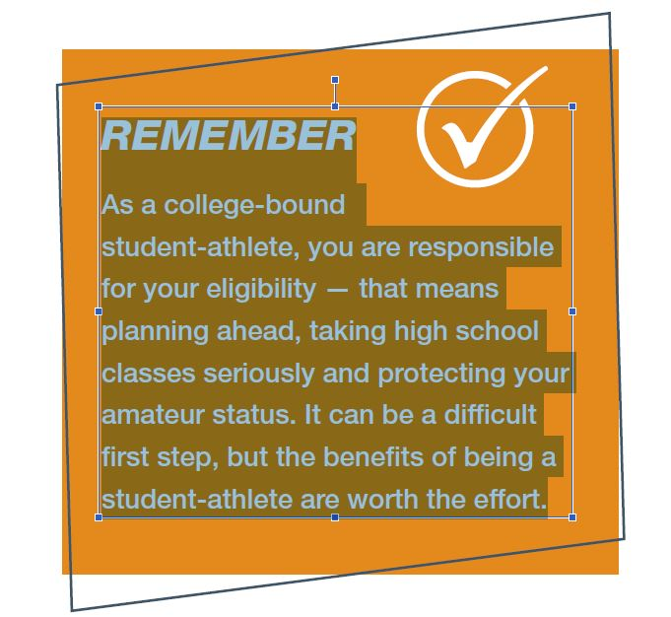

Slide 10
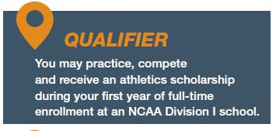
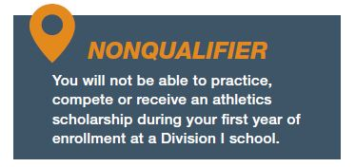
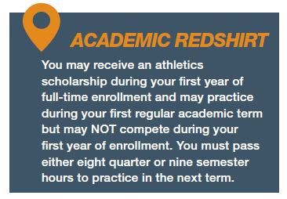
ELIGIBILITY CENTER
www.eligibilitycenter.com
Once a certification has been completed, you will receive one of the following decisions if you are being recruited by a Division I school.

Slide 11
ELIGIBILITY CENTER
www.eligibilitycenter.com
FULL QUALIFIER | ACADEMIC REDSHIRT | NONQUALIFIER
May accept a scholarship, practice the first year and play. | Scholarship the first year, practice in first regular semester or quarter only but may NOT play. Must pass 8 quarter or 9 semester hours to practice in the next term. | No Scholarship No Practice No Competitions the first year.
* Must have a minimum 2.3 Core GPA
* Complete 10 Core-Courses before the start of Senior Year
7 Must be in English, Math or Science
* These 10 core-courses become LOCKED IN for GPA calculations.

Slide 12
ELIGIBILITY CENTER
www.eligibilitycenter.com
DIVISION I & II – Requirements for incoming Freshman
Complete and Pass 16 Core-Courses
4 Years of English
3 Years of Math (Algebra 1 or Higher)
2 Years of Natural/Physical Science (including 1 year of lab science if offered)
2 Years of Social Science
1 Additional year of English, Math or Natural/Physical Science
4 Additional years of English, Math, Natural/Physical Science, social science, foreign language, comparative religion or philosophy.
4 x 4 = 16
4 English, 4 Math, 4 Science and 4 Social Science Courses

Slide 13
ELIGIBILITY CENTER
www.eligibilitycenter.com
DIVISION I & II – Requirements for incoming Freshman
Complete and Pass 16 Core-Courses
What is a CORE-COURSE?
Be an academic, four-year college preparatory course in one of the subject areas.
English, Math, Natural/Physical Science, Social Science, Foreign Language,
Comparative Religion or Philosophy
Be taught at or above your high school’s regular academic level.
Receive credit toward high school graduation and appear on an official transcript with
Course title, grade, and credit awarded.

Slide 14
ELIGIBILITY CENTER
www.eligibilitycenter.com
DIVISION I & II – Requirements for incoming Freshman
Complete and Pass 16 Core-Courses
Where do you find a full listing of approved CORE-COURSES?
https://web3.ncaa.org/hsportal/exec/hsAction?hsActionSubmit=searchHighSchool

Slide 15

ELIGIBILITY CENTER
www.eligibilitycenter.com

Slide 16
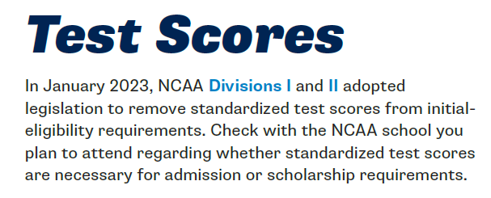
ELIGIBILITY CENTER
www.eligibilitycenter.com
Note: ALL SAT and ACT test scores must come directly from the testing agency and will not be accepted via an official High School Transcript.
Students who registers with the Eligibility Center can have their SAT and ACT scores sent directly to the Eligibility Center –
just Enter Code “9999” where it asks where you want scores sent.

Slide 17
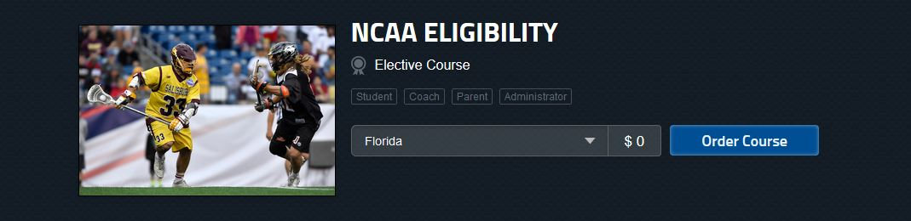
NFHSLEARN.com
NCAA Eligibility
This course is designed to educate high school coaches, administrators, and parents about the NCAA's initial-eligibility requirements. After completing the course, you will be more knowledgeable and prepared to advise your student-athletes about the NCAA initial-eligibility standards, as well as the steps student-athletes need to complete in order to compete in NCAA Divisions I and II athletics.

Slide 18
What is the NAIA – is a govering body of small athletics programs that are dedicated to character-driven intercollegiate athletics.
NAIA FACTS
250 Colleges and Universities and 21 Conferences
25 National Championships
65,000 Students
$500 Million in Athletic Scholarships!
.
The NAIA is not the NCAA and is their own governing association.
The NAIA has their own Eligibility Center and requirements for participation.
Registration cost is $100.00 / International student fee is $160.00

Slide 19
ELIGIBILITY CENTER
www.naia.org
Must meet 2 (two) of the 3 (three) requirements to be eligible as a freshman.
Test Score Requirement | High School GPA Requirement | Class Rank Requirement
18 Composite score on ACT 970 on the SAT | Achieve a minimum 2.0 on a 4.0 scale | Graduate the top half of your high school class.
HOME SCHOOL STUDENTS
Home School students who have a 20 on the ACT or 1040 on the SAT are considered to have met the freshman eligibility requirement. students who have a 20 on the ACT or

Slide 20
ELIGIBILITY CENTER
www.playnaia.org
Note: ALL SAT and ACT test scores must come directly from the testing agency and will not be accepted via an official High School Transcript.
Students who registers with the Eligibility Center can have their SAT and ACT scores sent directly to the Eligibility Center –
just Enter Code “9876” where it asks where you want scores sent.

Slide 21
Create your BLUEPRINT for Success
AND
Know the rules and continue to educate yourself on each Association
NCAA | NAIA
www.ncaa.com | www.naia.org
www.eligibilitycenter.com | www.playnaia.org

Slide 22
Thank you for Attending
AND
Ryan H. Adams, CMAA (ryan.adams@osceolaschools.net)
Coordinator of Athletics, Physical Education and Driver Education
School District of Osceola County, Kissimmee, Florida

